Slide 1

INSTITUTE :UIE
DEPARTMENT: ACADEMIC UNIT 1&4
Bachelor of Engineering (Computer Science & Engineering)
Subject Name and Code:
Quantum and Semiconductor Physics Lab
20SPP-182
Prepared by: Anjana Sharma, Assistant Prof. Physics
DISCOVER . LEARN . EMPOWER
PLANK’S CONSTANT

Slide 2
Importance of Advanced Engineering Physics
The electrical devices which are used as home appliances are based on physics rules and laws.
Automobile technology is based on the principle of thermodynamics.
Lasers are widely used in medical sciences.
Radar technology is based on the rules of Physics.
Nuclear energy is used on a large scale to produce electric power.

Slide 3
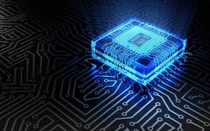
COURSE OBJECTIVES
To train engineering students in basics of measurements and the instruments.
To give practical training on basic Physics experiments which are useful to engineers.
To equip the students with practical knowledge in electronics and optics.
Figure 1 [1]

Slide 4
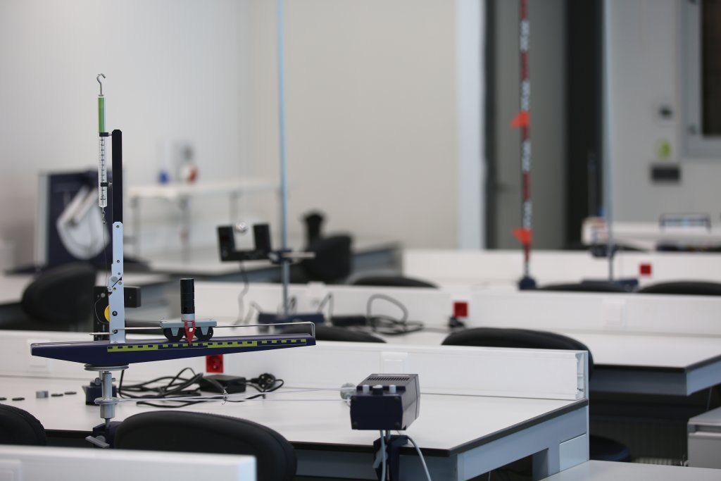
COURSE OUTCOMES
CO Number | Title On completion of this course, the students are expected to learn | Level
CO1 | It will provide the modest experience that allows students to develop and improve their experimental skills and develop ability to analyze data. | Understand Applying Analyze
CO2 | Ability to demonstrate the practical skill on measurements and instrumentation techniques of some Physics experiments. Students will develop the ability to use appropriate physical concepts to obtain quantitative solutions to problems in physics. | Understand Applying Analyze
CO3 | Students will demonstrate basic experimental skills by setting up laboratory equipment safely and efficiently, plan and carry out experimental procedures, and report verbally and in written language the results of the experiment. | Understand Applying Analyze
Figure 2 [2]

Slide 5
LIST OF EXPERIMENTS
To determine the Hall Voltage and Hall Coefficient Using Hall Effect.
To determine the resistivity of semiconductors by four probe Method.
To draw the static current- voltage characteristics of a Zener diode.
To calculate the frequencies at constant intensity for material using photoelectric effect.
To determine the diffraction using LASER beam and find the grating element of diffraction grating.
To determine the numerical aperture of optical Fiber.
To find the divergence of LASER beam.
Determination of ‘h’ using photocell.
To find the velocity of ultrasonic wave in the given liquid.
Investigating the Doppler Effect with ultrasonic waves.

Slide 6
COURSE OBJECTIVES
To train engineering students in basics of measurements and the instruments.
To give practical training on basic Physics experiments which are useful to engineers.
To equip the students with practical knowledge in electronics and optics.

Slide 7
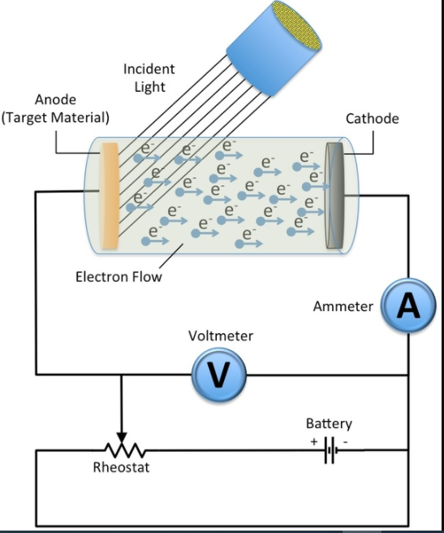
EXPERIMENT TO BE DISCUSSED…
Determination of value of Planck’s constant ‘h’ using photo cell.
Figure 3 Planck’s Constant [3]

Slide 8
AIM: Determination of value of Planck’s constant ‘h’ using photo cell.
Apparatus:
Table1. List of Equipments used:
S.N. | Equipment | Range | Quantity
1 | Digital Voltmeter (DVM) to measure the voltage across the LEDs | 0-20V | 1
2 | Micro-ammeter to determine the current through LEDs | 30 µA | 1
3 | Jack J to connect the LEDs | Different colors | 4

Slide 9
Pre-preparation/ Prerequisite
Student is advised to understand the fundamental aspects of Planck’s Constant before carrying out the experiment:
Basic principle of photoelectric effect.
Principle used in Planck’s constant.
Application of Photo Cell.

Slide 10
Theory
The objective of this experiment is to determine Planck's constant using light emitting diodes (LED's) by observing the ’reverse photo-electric effect’. In the case of the photoelectric effect, an electron is emitted from a metal if the energy of the photon is greater than the work function of the metal. If the energy of said photon is greater than the work function of a given material then the electron emitted possesses a voltage, which equals the difference in these energies. In the case of an LED's the opposite is true. If an electron of sufficient voltage is passed across a material then a photon is emitted whose energy is equivalent to the work function of that material. The voltage at which this effect is first observed is the 'turn on voltage'.

Slide 11
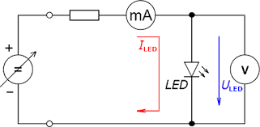
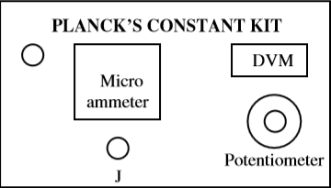
Planck’s Constant diagram
Figure 4(a) Planck’s Constant Kit.
Figure 4 (b) Circuit Diagram Of Planck Constant [4].

Slide 12
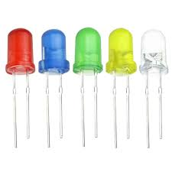
LED’s
A light-emitting diode (LED) is a semiconductor light source that emits light when current flows through it.
Electrons in the semiconductor recombine with electron holes, releasing energy in the form of photons. The color of the light (corresponding to the energy of the photons) is determined by the energy required for electrons to cross the band gap of the semiconductor.
White light is obtained by using multiple semiconductors or a layer of light-emitting phosphor on the semiconductor device.
Figure 5 LED’s [5]

Slide 13
Theory and Formula Used
When a semiconductor is doped with impurities of the III periodic group elements it then has a lack of electrons in the valance band.
Formula Used
E= hʋ (1)
E=eV (2)
Where e = 1.6 × 10⁻¹⁹ C
We then solve equation (1) for h and replace the E term with the equivalent of E in equation (2), as well as replace υ with:
υ=c/ λ
Where c = 3 × 10⁸ m/sec
We then get:
h=eV λ/c (3)
this equation can be rewritten as
V=hc/e λ (4)
It is this equation that we will use to determine Planck's constant.
Where h is Planck’s Constant, ʋ is the frequency of light

Slide 14
Procedure
1.Connect the L.E.D. to the jack provided on the front panel and switch ON the unit.
2. Take the different voltage and current measurement of LED (as tabulated below) for V-I characteristic of LED:
3. Take different LEDs and follow step 2.
4. Now plot the V-I characteristics of all the LEDs on graph paper and take voltages corresponding to a constant current as shown on graph in next page.
Formula Used
υ=hc/e λ

Slide 15
Observation Table & Calculations
S.No. | L.E.D. Colour | Wavelength λ (nm) | 1/ λ | Stoppage Voltage V (volts) | Energy (J) E=eV | Frequency υ = c/ λ | h=eV λ/c
1 | Red | 650
2 | Green | 510
3 | Yellow | 570
4 | Blue | 475
Now plot a graph between voltage (V) vs.1/λ and determine the slope of the line.

Slide 16
Result (s): The value of Planck’s constant ‘h’= Js
Conclusion: Our experimental value of Planck’s constant was well within the limits set by experimental uncertainty.

Slide 17
Sources of Errors:
The experiment should be performed such that the glow of LEDs is properly visible.
The value of voltmeter and ammeter should be noted with least count.
The surface on which the apparatus rest should be flat with no surface leakage.

Slide 18
Learning Outcomes:
On Completion of the experiment ,students will be able to understand
The Photoelectric effect.
To find the Planck’s constant of the material using voltage and current.
Use of different colour LED’s to find value of Planck’s Constant.

Slide 19
Summary
Introduction of LED’s and Rheostat
Formula used to calculate Planck’ Constant
Observation Table and Calculations
Sources of error

Slide 20
Evaluation Pattern
Sr. No. | Parameters | Maximum Marks | Marks Obtained
1. | Worksheet completion including writing learning objectives/Outcomes. (To be submitted at the end of the day) | 10
2. | Post Lab Quiz Result. | 5
3. | Student Engagement in Simulation/Demonstration/Performance and Controls/Pre-Lab Questions. | 5
4. | Total Marks | 20
5. | Teacher’s Signature (with date)

Slide 21
REFERENCES
[1] https://images.app.goo.gl/onXTfVDfo1WiwTcK9
[2] https://in.pinterest.com/pin/842243567793191631/
[3] https://qph.fs.quoracdn.net/main-qimg-05460cdca5570bce106259bef3dbb34f
[4] https://encrypted-tbn0.gstatic.com/images?q=tbn%3AANd9GcTQiSFC0GqYyj-xc50GWY_Iur3ov7AHRJh9fA&usqp=CAU
[5] https://en.wikipedia.org/wiki/Light-emitting_diode

Slide 22
THANK YOU
For queries:-
Anjana.e1643@cumail.in

